Slide 1
2021-22 NFHS Volleyball Rules PowerPoint FOR NHIAA Coaches
Rules Changes
Points of Emphasis
NHIAA Policies and Procedures

Slide 2
2021-22 NFHS Volleyball
Rules Changes

Slide 3
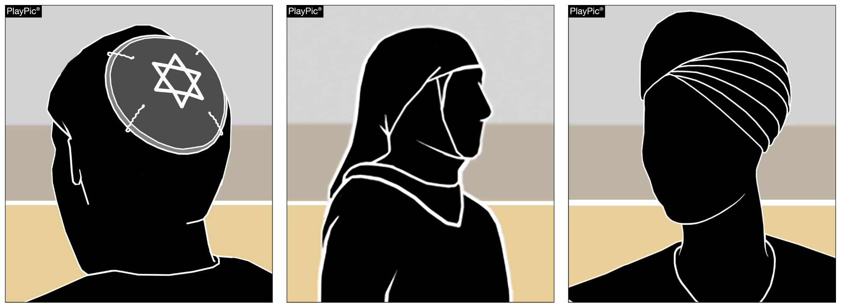
Rule 4-1-6a, b (new)
Legal hair devices such as bobby pins and flat clips, no longer than two inches, may be used to secure head coverings. (4-1-6)
Players may wear head coverings for religious reasons.
The headwear must fit securely and be made of non-abrasive or soft materials.
Head coverings worn for medical reasons must still receive state association approval.
Notes:
Players may wear head coverings for religious reasons.
The headwear must fit securely and be made of non-abrasive or soft materials.
Legal hair devices such as bobby pins and flat clips, no longer than two inches, may be used to secure head coverings. (4-1-6)
Other fasteners that do not adhere to Rule 4-1-6 (those that are not flat or are longer than 2 inches) will be prohibited for the purposes of risk minimization.
Head coverings worn for medical reasons must still receive state association approval.
Rationale: This change eliminates the need for authorization from the state association for the wearing of religious headwear without data to support that this type of head wear creates an increased risk to the athlete or teammates, while maintaining the requirement for approval of head coverings worn for medical reasons – allowing the state association to review for the purposes of risk minimization.

Slide 4
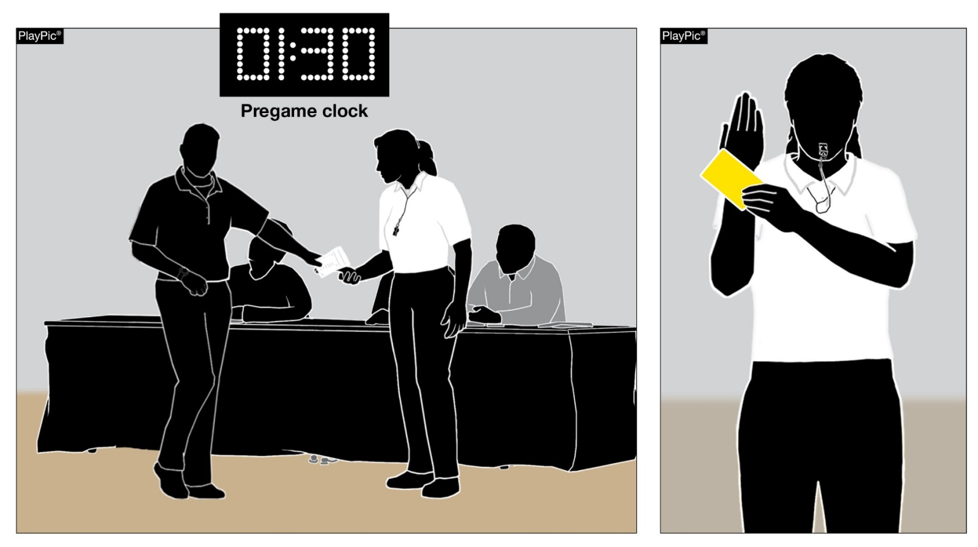
Rules 7-1-4 penalties(1), 9-9-1b (new)
When a head coach submits a lineup after two minutes remain on the prematch clock, an unnecessary delay (administrative yellow card) is assessed at the start of set No. 1.
Lineups are due to the second referee no later than two minutes prior to the end of the timed prematch warmup (7-1-2a).
Notes:
Lineups are due to the second referee no later than two minutes prior to the end of the timed prematch warmup (7-1-2a).
When a head coach submits a lineup after two minutes remain on the prematch clock, an unnecessary delay (administrative yellow card) is assessed at the start of set No. 1.
Rationale: This change aligns the penalty for late lineup with that of a late roster. In addition, it lessons the severity of a late lineup by eliminating the automatic loss of rally/point penalty previously assessed.

Slide 5
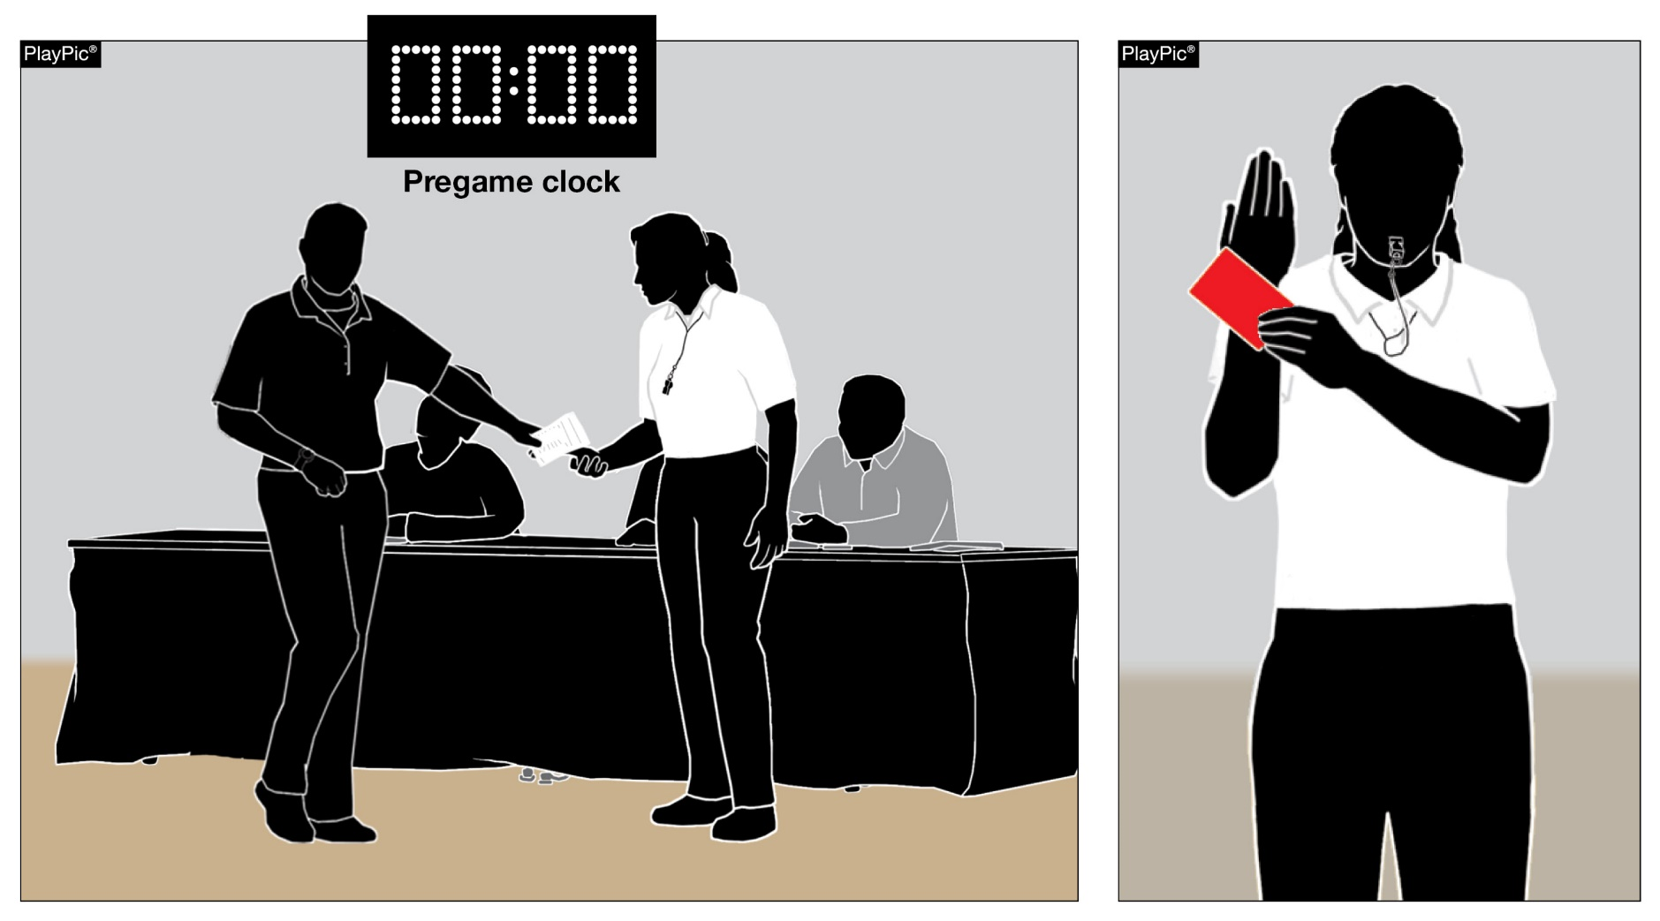
Rules 7-1-4 penalties(1), 9-9-1b (new)
If the head coach has not submitted the lineup by the end of the prematch warmup, a subsequent unnecessary delay (administrative red card) is assessed at the start of set No.1, which results in a loss of rally/point awarded to the opponent.
Notes:
If the head coach has not submitted the lineup by the end of the prematch warmup, a subsequent unnecessary delay (administrative red card) is assessed at the start of set No.1, which results in a loss of rally/point awarded to the opponent.
Rationale: This change allows for an appropriate penalty escalation.

Slide 6

Rules 7-1-4 penalties(2), 9-9-1b (new)
Lineups are due to the second referee no later than one minute prior to the end of the timed interval/ intermission between sets (7-1-2b).
When a head coach submits a lineup after one minute remains on the clock, an unnecessary delay (administrative yellow card) is assessed at the start of the next set.
Notes:
Lineups are due to the second referee no later than one minute prior to the end of the timed interval/ intermission between sets (7-1-2b).
When a head coach submits a lineup after one minute remains on the clock, an unnecessary delay (administrative yellow card) is assessed at the start of the next set.
Rationale: This change mirrors the previous change made for a late lineup before Set No. 1. The penalty also applies for late lineups between sets Nos. 2-5.

Slide 7

Rules 7-1-4 penalties(2), 9-9-1b (new)
If the head coach has not submitted the lineup by the end of the timed interval/ intermission between sets, a subsequent unnecessary delay (administrative red card) is assessed at the start of the next set, which results in a loss of rally/point awarded to the opponent.
Notes:
If the head coach has not submitted the lineup by the end of the timed interval/ intermission between sets, a subsequent unnecessary delay (administrative red card) is assessed at the start of the next set, which results in a loss of rally/point awarded to the opponent.
Rationale: This change mirrors the previous change made for a late lineup before Set No. 1. The penalty also applies for late lineups between sets Nos. 2-5.

Slide 8
2021-22 NFHS Volleyball
Points of Emphasis

Slide 9
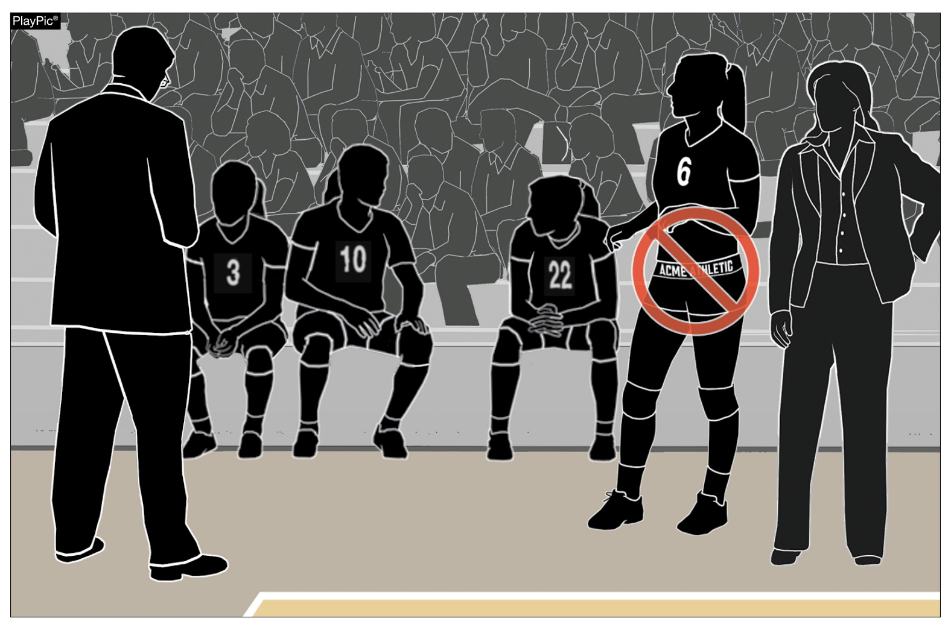
Addressing uniform concerns
Manufacturer’s Logo Restriction:
Logos cannot exceed 2.25 square inches
Only one logo is permitted on each piece of the uniform including the waistband.
Notes:
To avoid penalties related to uniforms, the committee would like to emphasize the following rules regarding uniform requirements:
Manufacturer’s Logo Restriction:
Logos cannot exceed 2.25 square inches
Only one logo is permitted on each piece of the uniform including the waistband.

Slide 10
Note: Logo Restriction
The logo restrictions apply only to the uniform which includes the shirt, bottoms and undergarments such as spandex . It does not include socks, shoes, headbands etc.

Slide 11
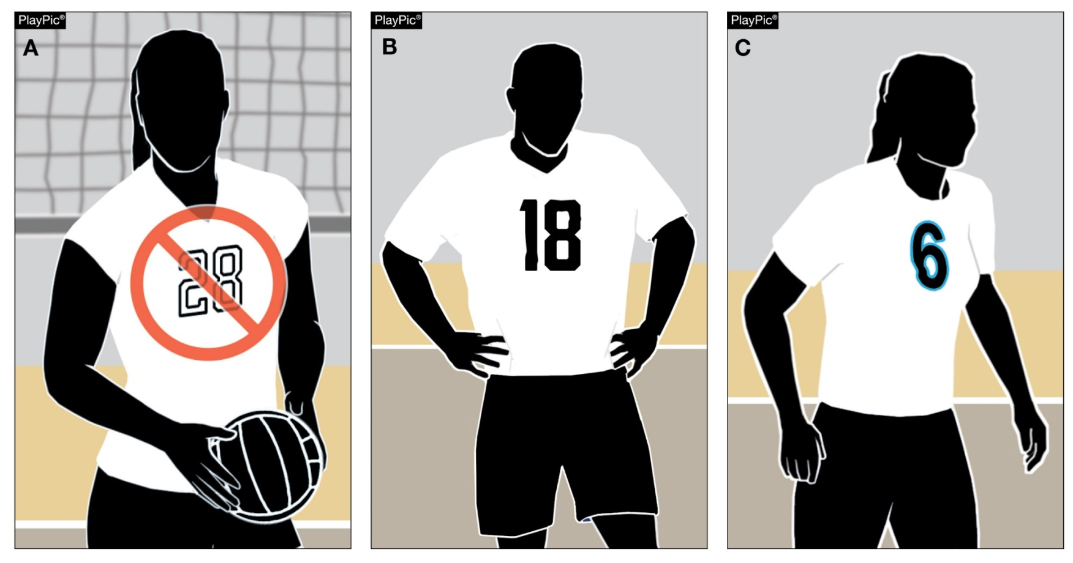
Addressing uniform concerns
Numbers:
When ordering new uniforms, refer to Rule 4-2-4 for number size and location requirements.
Beginning in the 2023 season, the body of the number must clearly contrast from the body of the uniform regardless of trim.
Notes:
Numbers:
When ordering new uniforms, refer to Rule 4-2-4 for number size and location requirements.
Beginning in the 2023 season, the body of the number must clearly contrast from the body of the uniform regardless of trim.

Slide 12
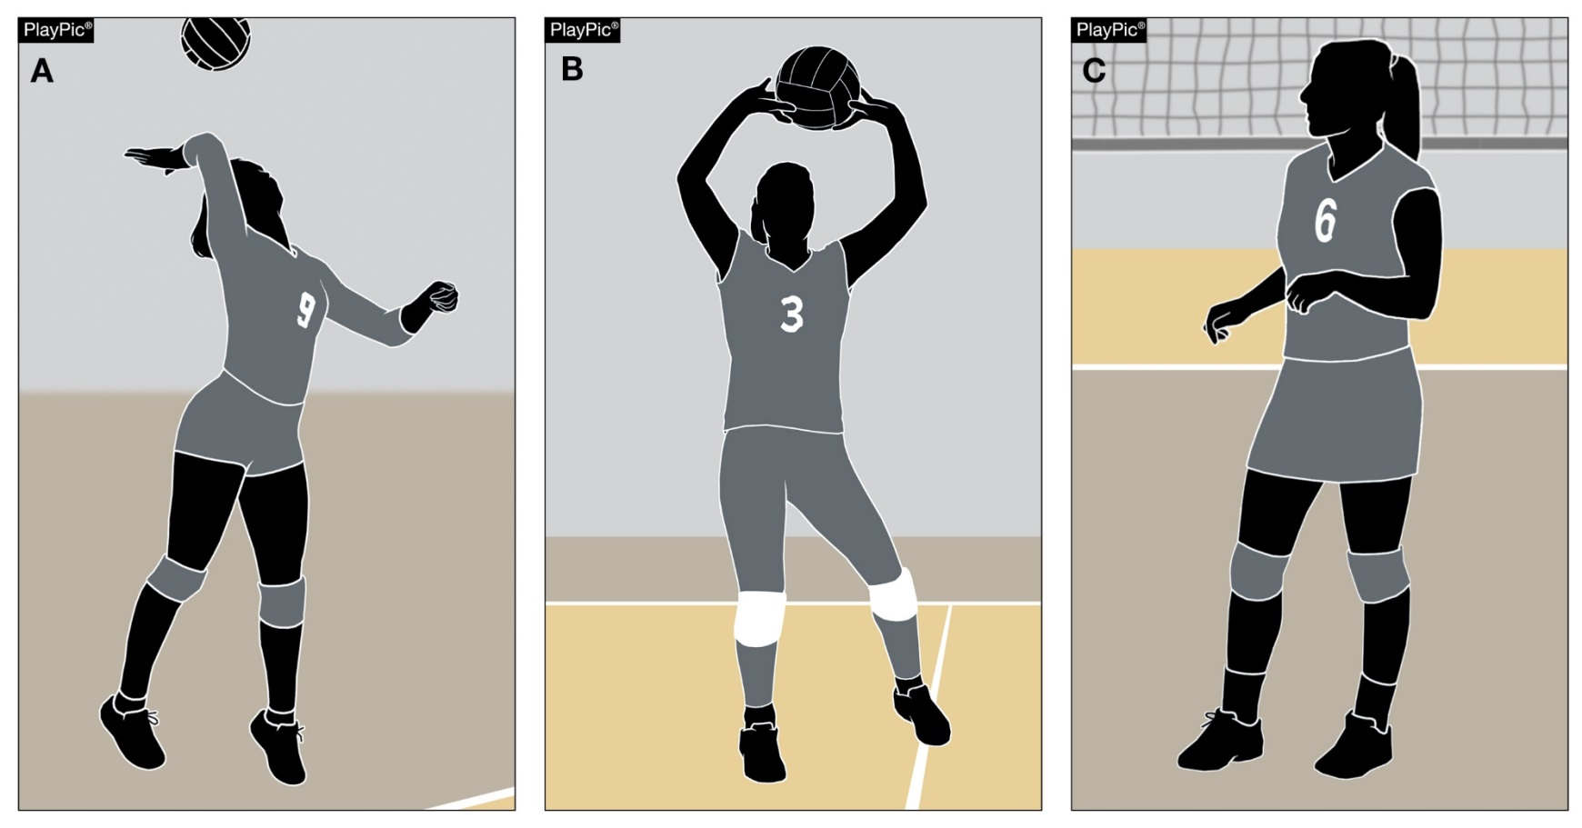
Addressing uniform concerns
Style of Uniform Bottoms:
Multiple styles of uniform bottoms [shorts, spandex, pants (leggings) or skirts] are allowed by rule.
A combination of like-colored bottoms may be worn within a team.
Notes:
Style of Uniform Bottoms:
Multiple styles of uniform bottoms [shorts, spandex, pants (leggings) or skirts] are allowed by rule.
A combination of like-colored bottoms may be worn within a team.

Slide 13
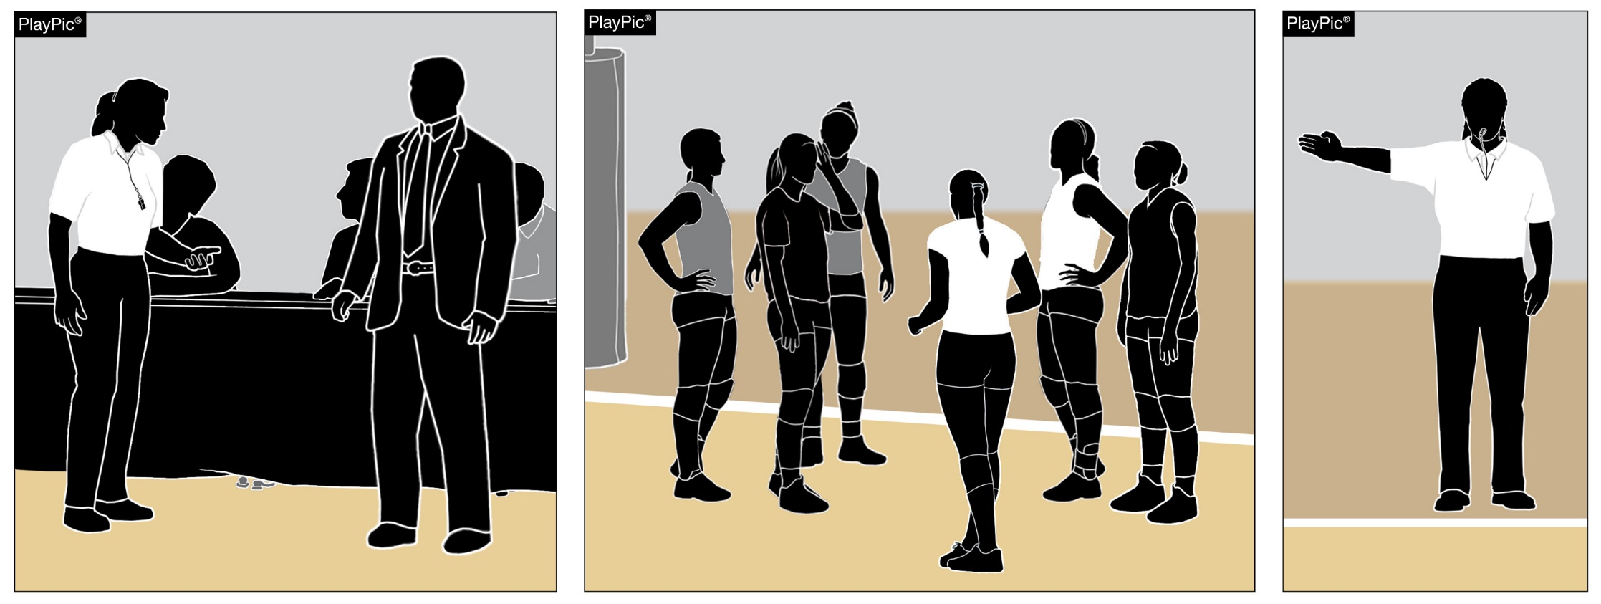
Addressing uniform concerns
Process of Notification: The official shall first notify the coach about the illegal uniform(s). If the coach cannot fix the problem for the match and therefore does not have six players wearing legal uniforms, a loss of rally/point shall be awarded to the opponent at the beginning of the match and the state association shall be notified.
Notes:
Process of Notification: The official shall first notify the coach about the illegal uniform(s). If the coach cannot fix the problem for the match and therefore does not have six players wearing legal uniforms, a loss of rally/point shall be awarded to the opponent at the beginning of the match and the state association shall be notified.
The goal is to allow teams to compete provided there are no safety concerns and allow the state office to work with the school to correct the issue(s).

Slide 14
NHIAA Policies and Procedures
Review Fall Sports: Volleyball Policy and Procedure Manual
NHIAA Website

Slide 15
Scorer’s Table
No cell phones
Official scorer will be seated next to timer.
Tracker will sit next to Official Scorer
Visiting scorer will sit next to tracker, if there is room.
Home team will supply the tracker

Slide 16
PreMatch Warm ups:
*3-6-6-3
3-minute transition time (following JV match)**clock starts when jv match finishes.
6- minute visiting team
6- minute home team
3- minute shared time
During the 6 minute warm up time for each team the opposing team may not be warming up (of any kind) in the same gym.
During the 3-minute transition and shared time teams must remain on their own side of the court. No serving is allowed.

Slide 17
Stopping Matches for Milestone Recognition
During a regular season match a set may be stopped to celebrate a milestone (i.e. 500 kills, 1000 assists, etc.) and the celebrating team will not be charged a timeout. Teams will report to the bench areas for a brief ceremony and then return to the court. Post season matches will not be stopped.

Slide 18
Coaches Conduct on Influencing Decisions
NFHS Volleyball Rule 12, Section 2, Article 8C states that it is unsporting like conduct for a coach to attempt to “influence a decision by a referee”. Coaches that visually signal line calls will be subject to sanctions as outlined in NFHS Rule 12-2-8C. This does not prohibit coaches from verbally communicating to his/her players that a ball is going out. It is also a point of emphasis that players should not be trying to “influence” the calls of officials.
First offense- verbal warning
Second Offense- Yellow card
Third offense- Red card ( Head coach sits for remainder of match)

Slide 19
Late Arriving Teams
If a visiting team fails to arrive at a contest at its’ scheduled start time, without notifying the home school, the officials shall not wait longer than 45 minutes. After the 45 minute wait the game will be called as a “no game.” In the event the visiting team calls ahead to inform the home school they are experiencing difficulties arriving for the start of the contest the officials shall remain in order to start the contest.
****** Volleyball Committee has decided that if the visiting team is running late the officials may use their discretion regarding the order of warm-ups for the JV match.

Slide 20
Tournament Ball
Wilson
K1 Gold Item # WTH1895A1XB Red, White and Blue
http://www.nhiaa.org/ckfinder/userfiles/files/202122%20Tournament%20Balls%20List.pdf

Slide 21
Covid Protocols
As of today the NHIAA has not mandated any COVID protocols BUT this is still a changing situation and individual schools may adopt protocols concerning masks, spectators, ball sanitizing, etc.
The NFHS has extended the COVID rules modifications through the 2021-22 school year allowing state associations to modify as needed.
If adoption of any of these modifications takes place your Athletic Director will be notified.

Slide 22
Questions During The Season
Rule Clarifications- Contact Rules Interpreter Rick Forge forge@worldpath.net
Facility/Official issues- Contact Supervisor Phil Mollica pmoll2001@yahoo.com
Scheduling issues- Contact Assigner Dick Dumais ddumais11@gmail.com

